Slide 1

Kenya Medical Training College
Faculty of Clinical Sciences
Department Of Orthopaedics and Trauma Medicine
Year Two Semester One
General Orthopaedics I
By
Gideon Sifirino
Class: Diploma March 2022
17th,April, 2023

Slide 2
Learning outcomes
By the end of this presentation the learner should be able to;
Classify arthritis
Discuss septic arthritis and spirochaete
infection under the following sub headings; definition, causes, mode of infection/spread, risk factors, predisposing factors, pathology, investigations, management, complications, differential diagnosis and prognosis.

Slide 3
Introduction
Arthritis; joint inflammation

Slide 4
Cont’d
Clinically, arthritis falls into the following groups:
Osteoarthritis
Primary
Secondary
b. Rheumatoid arthritis
Adult
Juvenile

Slide 5
Cont’d
c. Infective arthritis
Acute
Chronic
d. Metabolic arthritis
Gout
Pseudogout
e. Nonspecific monoarthritis
f. Neuropathic joint disorders, e.g. Charcot’s

Slide 6
Infective Arthritis/ Pyogenic Infection of Joint or Septic Arthritis
Definition
Presence of pus in the joint
secondary to infection of the joint,
(Shenoy, 2010).
bacterial infection of the joint, which causes an intense inflammatory reaction with migration of polymorph nuclear leucocytes, and subsequent release of proteolytic enzymes, (Ebnezer, 2012).

Slide 7
Cont’d
Bacterial infection of the joint, which
causes an intense inflammatory reaction with migration of polymorph nuclear leucocytes, and subsequent release of proteolytic enzymes, (Ebnezer, 2012).

Slide 8
Mode of Infection
Direct invasion through a penetrating wound, intra-articular injection or arthroscopy
Direct spread from an adjacent bone
abscess.
Blood spread from a distant site

Slide 9
Causative Organisms
Staphylococcus aureus
Streptococcus
Pneumococcus
Gonococcus
Escherichia coli
Haemophilus influenzae
Proteus

Slide 10
Predisposing Factors
Rheumatoid arthritis
Chronic debilitating disorders
Intravenous drug abuse
Immunosuppressive drug therapy
AIDS
Trauma
Diabetes
Steroid therapy
Malignancy

Slide 11
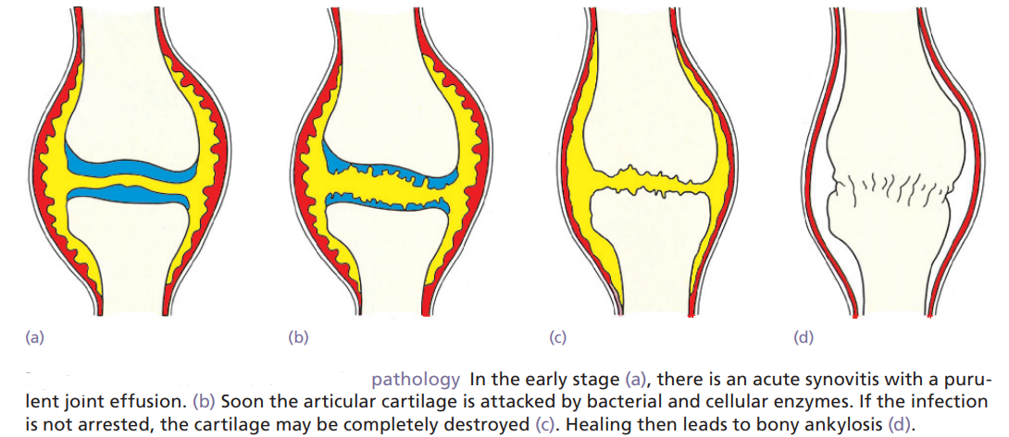
Pathology

Slide 12
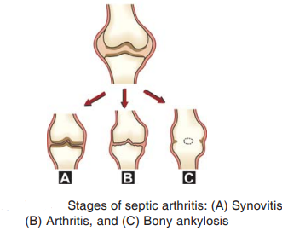

Slide 13
Clinical Features
In new born infants
Emphasis is on septicaemia rather than
joint pain.
The baby is irritable and refuses to feed
Rapid pulse fever warmth
Tenderness
Resistance to movement

Slide 14
In children
Acute pain in a single large
joint (commonly the hip or the knee)
Reluctance to move the limb (pseudoparesis)
The child is ill, with a rapid pulse
Swinging fever

Slide 15
Cont’d
The overlying skin looks red
Superficial joint swelling may be obvious.
There is local warmth
Marked tenderness
All movements are restricted by pain and spasm

Slide 16
In adults
Superficial joint pain (knee, wrist, a
finger, ankle or toe)
Swelling
Warmth
Marked local tenderness
Restriction of movements

Slide 17
Investigations
Laboratory Investigations
Joint Aspirate and Synovial Fluid Analysis
WBCs (polymorphs) are raised
ESR increased
Hb percentage decreases.
Blood culture is positive
CRP

Slide 18
Imaging
Ultrasonography joint effusion in early cases.
Widening of the space between capsule and bone of more than 2 mm
X-ray examination soft-tissue swelling, loss of tissue planes, widening of the radiographic ‘joint space’ and slight subluxation

Slide 19
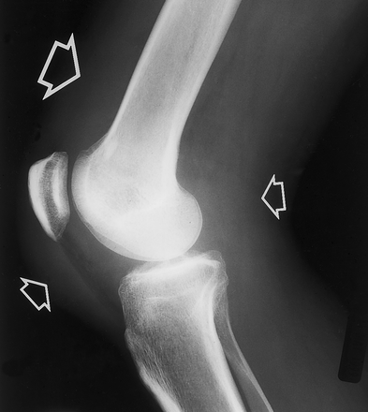

Slide 20
Cont’d
Early Stages (radiographs)
Soft tissue swelling and periarticular osteoporosis.

Slide 21
Cont’d
Late Stages
Cartilage destruction, and loss of joint space, necrosis of bone epiphyseal disturbances, fibrous ankylosis, and bony ankylosis
With some infections there is sometimes
gas in the joint. Narrowing and
irregularity of the joint space.

Slide 22
Cont’d
MRI and radionuclide imaging are helpful
in diagnosing arthritis in obscure sites
such as the sacroiliac and sternoclavicular
joints.

Slide 23
Treatment
Arthrotomy or joint drainage: the joint is aspirated first, if pus is present, open Arthrotomy is indicated. The pus is cultured and is subjected to gram staining.

Slide 24
Cont’d
Appropriate antibiotics are then chosen and are given intravenously before surgical drainage.
Antibiotics are used for a minimum
period of 2-4 weeks.

Slide 25
Cont’d
Neonates and infants up to the age of 6 months
Penicillinase-resistant Penicillins (e.g. flucloxacillin) plus a third-generation cephalosporin
Children from 6 months to puberty
can be treated similarly.

Slide 26
Cont’d
Older teenagers and adults
Can be started on flucloxacillin and fusidic acid. If the initial examination shows Gram-negative organisms a third-generation cephalosporin is added.
Analgesics; pain and IV fluids; dehydration.

Slide 27
Cont’d
Immobilization of the joints by using
plaster of Paris splints in functional
position reduces pain.

Slide 28
Complications
Joint destruction
Pathological dislocation
Osteoarthritis in later years
Ankylosis—fibrous or bony
Acute osteomyelitis
Amyloidosis very rarely develops.
Septicaemia
Pyemia

Slide 29
Differential diagnosis
Acute osteomyelitis
Traumatic synovitis or haemarthrosis
Rheumatic fever
Juvenile rheumatoid arthritis
Sickle-cell disease
Gaucher’s disease
Gout and pseudogout

Slide 30
Thank you

Slide 31
Gonococcal Arthritis
Neisseria gonorrhoea is the commonest cause
of septic arthritis in sexually active
adults, especially among poorer populations.

Slide 32
Mode of Infection
The infection is acquired only by
direct mucosal contact with an infected
person – carrying a risk of greater
than 50% after a single contact.
It usually results due to lack
of treatment for gonorrhoea.

Slide 33
Pathology
Synovitis
Effusion
Cartilage erosion
Destruction of cartilage

Slide 34
Clinical features
Gonococcal arthritis is usually sudden in onset.
The patient presents with chills, fever, pain and swelling of the joint.
On examination, there is raised temperature and tenderness.

Slide 35
Cont’d
There may be history of urethral discharge.
There may be slight pyrexia
NB; The disease may become chronic due
to inadequate and improper treatment.

Slide 36
Investigations
ESR and WBC count will be raised
Joint aspiration; high white blood cell count

Slide 37
Treatment
Third-generation cephalosporin ;IV or IM

Slide 38
However, bear in mind that many patients with Gonococcal infection also have chlamydial infection, which is resistant to Cephalosporins; both are sensitive to quinolone antibiotics such as ciprofloxacin and ofloxacin.

Slide 39
Cont’d
If the organism is found to be
sensitive to penicillin (and the patient
is not allergic), treatment with ampicillin
or amoxicillin and clavulanic acid
is also effective.

Slide 40
Cont’d
If the organism is found to be
sensitive to penicillin (and the patient
is not allergic), treatment with ampicillin
or amoxicillin and clavulanic acid
is also effective.

Slide 41
Cont’d
If the organism is found to be
sensitive to penicillin (and the patient
is not allergic), treatment with ampicillin
or amoxicillin and clavulanic acid
is also effective.

Slide 42
Cont’d
If the organism is found to be
sensitive to penicillin (and the patient
is not allergic), treatment with ampicillin
or amoxicillin and clavulanic acid
is also effective.

Slide 43
Cont’d
If the organism is found to be
sensitive to penicillin (and the patient
is not allergic), treatment with ampicillin
or amoxicillin and clavulanic acid
is also effective.

Slide 44
Cont’d
If the organism is found to be
sensitive to penicillin (and the patient
is not allergic), treatment with ampicillin
or amoxicillin and clavulanic acid
is also effective.

Slide 45
Cont’d
If the organism is found to be
sensitive to penicillin (and the patient
is not allergic), treatment with ampicillin
or amoxicillin and clavulanic acid
is also effective.

Slide 46
Cont’d
If the organism is found to be
sensitive to penicillin (and the patient
is not allergic), treatment with ampicillin
or amoxicillin and clavulanic acid
is also effective.

Slide 47
Cont’d
If the organism is found to be
sensitive to penicillin (and the patient
is not allergic), treatment with ampicillin
or amoxicillin and clavulanic acid
is also effective.

Slide 48
Cont’d
If the organism is found to be
sensitive to penicillin (and the patient
is not allergic), treatment with ampicillin
or amoxicillin and clavulanic acid
is also effective.

Slide 49
Cont’d
If the organism is found to be
sensitive to penicillin (and the patient
is not allergic), treatment with ampicillin
or amoxicillin and clavulanic acid
is also effective.

Slide 50
Cont’d
If the organism is found to be
sensitive to penicillin (and the patient
is not allergic), treatment with ampicillin
or amoxicillin and clavulanic acid
is also effective.

Slide 51
Cont’d
If the organism is found to be
sensitive to penicillin (and the patient
is not allergic), treatment with ampicillin
or amoxicillin and clavulanic acid
is also effective.

Slide 52
Thank you

Slide 53
Spirochaetal Infections
Two conditions which are likely to be encountered:
Syphilis
Yaws

Slide 54
Syphilis
Cause
Spirochaete Treponema pallidum

Slide 55
Mode of Infection
Sexual activity; direct contact with infectious lesions of the skin or mucous membranes

Slide 56
Pathology
The infection spreads to the regional lymph nodes and thence to the bloodstream. The organism can also cross the placental barrier and enter the fetal blood stream directly during the latter half of pregnancy, giving rise to congenital syphilis.

Slide 57
Cont’d
After a variable length of time, this phase is followed by a latent period which may continue for many years. The term is somewhat deceptive because in about half the cases pathological lesions continue to appear in various organs and 10–30 years.

Slide 58
Cont’d
Later the patient may present again with tertiary syphilis, which takes various forms including the appearance of large granulomatous gummata in bones and joints and neuropathic disorders in which the loss of sensibility gives rise to joint breakdown (Charcot joints).

Slide 59
Cont’d
In tibia the syphilitic osteitis causes diffuse thickening of the cortex and bending/bowing of the tibia which is classical.
The resultant deformity is known as ‘Sabre tibia’.

Slide 60
Investigations
Wassermann’s test is positive.
Treponema pallidum immobilization test is positive
Joint fluid aspiration and synovial fluid analysis for cell, sugar, protein etc.

Slide 61
Treatment
Early lesions will usually respond to intramuscular injections of benzyl penicillin given weekly for 3 or 4 doses.
An alternative would be treatment with
one of the third generation Cephalosporins.

Slide 62
Cont’d
Late lesions will require high-dosage intravenous penicillin for a week or 10 days
Antibiotic therapy in tertiary syphilis is
not very effective.

Slide 63
Thank you

Slide 64
Yaws
A non-venereal Spirochaetal infection caused by Treponema pertenue.

Slide 65
Risk Factors
It is seen mainly in the
poorer tropical parts of Africa, Asia
and South America.

Slide 66
Mode of Infection
The infection is contracted by
skin-to-skin contact.

Slide 67
Pathology
A knobbly ulcer covered by a scab (the primary or ‘mother’ yaw), usually develops on the face, hands or feet.
Secondary skin lesions appear 1–4 months later and successive lesions may go on to pustular ulceration; as each one heals it leaves a pale tell-tale scar.

Slide 68
Cont’d
This secondary stage is followed by a long latent period, merging into a tertiary stage during which skeletal changes similar to those of syphilis develop – periosteal new bone formation, cortical destruction and osteochondritis.

Slide 69
Clinical Features
Lymphadenopathy is quickly recognized.
Deformities and bone tenderness
X-rays show features such as:
Cortical erosion
Joint destruction
Periosteal new bone formation

Slide 70
Treatment
Benzyl penicillin, IM injection.
For those who are hypersensitive to penicillin, erythromycin is a satisfactory alternative.

Slide 71
Questions ???

Slide 72
Summary
It is important to understand the
pathogenesis of the infection, lab and radiological findings and the clinical features
as they forms the backbone in
differentiation of various bone conditions.

Slide 73
Reference
Ebnezer, J, (2012): Textbook of Orthopedics Fifth Edition:, Jaypee Brothers Medical Publishers (P) Ltd.
Duckworth, T, and Blundell, C.M, (2013) Orthopaedics and Fractures Fourth Edition:, Wiley-Blackwell publishers.
Shenoy, R.M, (2010), Essentials of Orthopedics, First Edition: Jaypee Brothers Medical Publishers (P) Ltd
www.https//:orthobullets.com

Slide 74
Assignment
Discuss the following:
Mon articular arthritis
Tom smith arthritis
Individual assignments
Source of information: library and internet

